Slide 1



ACTIVITAR
Team Members : Project Mentor :
Ashish Suman (2110992191) Ms. Shinnu Jangra
Ayush Saxena (2110992192)
Ayush Srivastava (2110992193)
Chiranshu (2110992197)

Slide 2


Index
Introduction
Technology Used
Demonstration
Roles

Slide 3

Introduction
Activitar is an outstandingly beautiful and impactful free fitness club website. We have created a website which caters to people who want to remain fit and healthy. With the flexible, dark and bold design, you will easily capture everyone’s attention. You can also activate blog pages and BMI calculator and increase user experience. Of course, Activitar also comes with multiple outstanding features and functions. Massive slider, call-to-actions, classes timetable, pricing plans, Google Maps and a working contact form are all the goodies included in Activitar. Moreover, you can also use blog pages and give back to the community via compelling content.

Slide 4
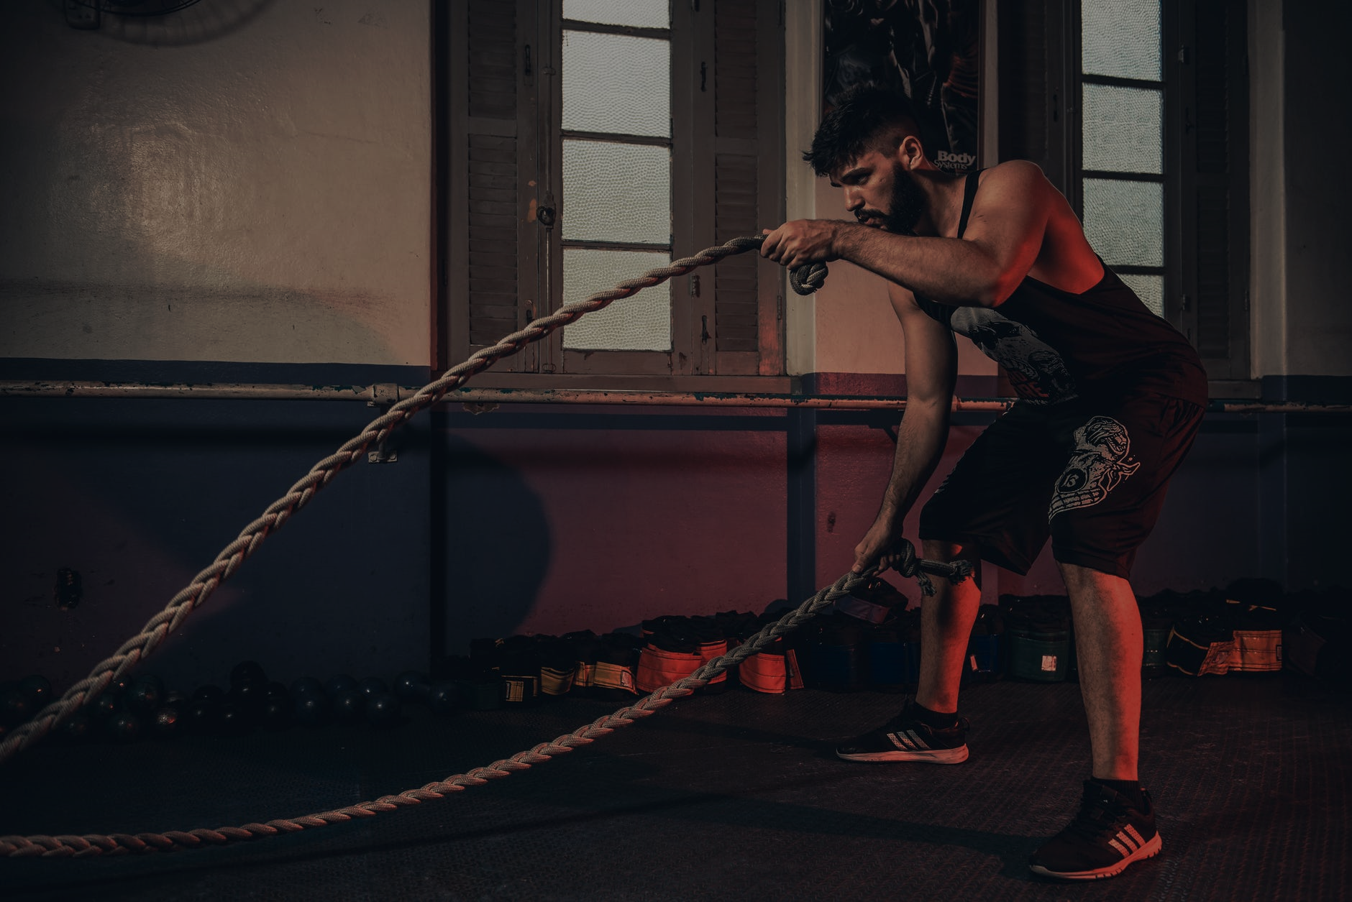
Technology Used
We have used HTML and CSS.
The files can be accessed in any browser.

Slide 5

Roles
Ashish Suman– Landing Page, Login /signup page, Membership page, Exercise page.
Ayush Saxena – BMI calculator, Calorie calculator, Diet Plan.
Ayush Srivastava – Blog page.
Chiranshu – Yoga page, Shopping page.

Slide 6
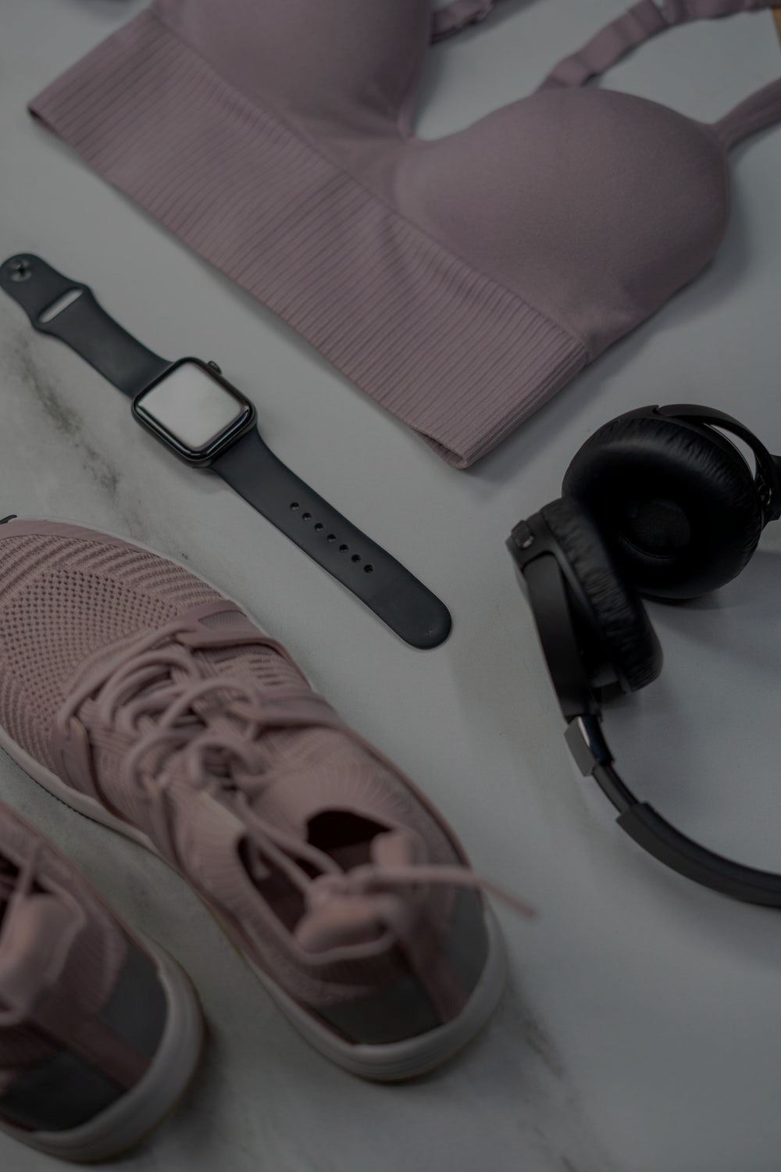
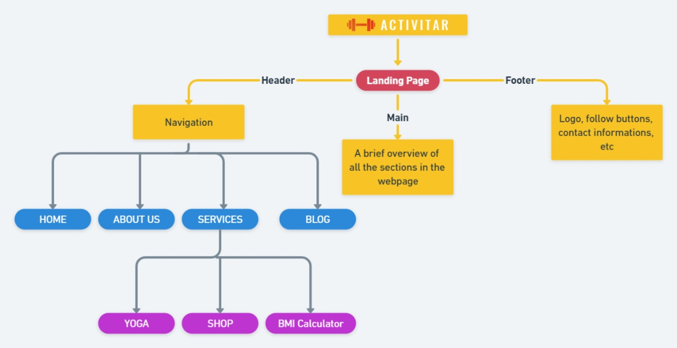
Demonstration

Slide 7
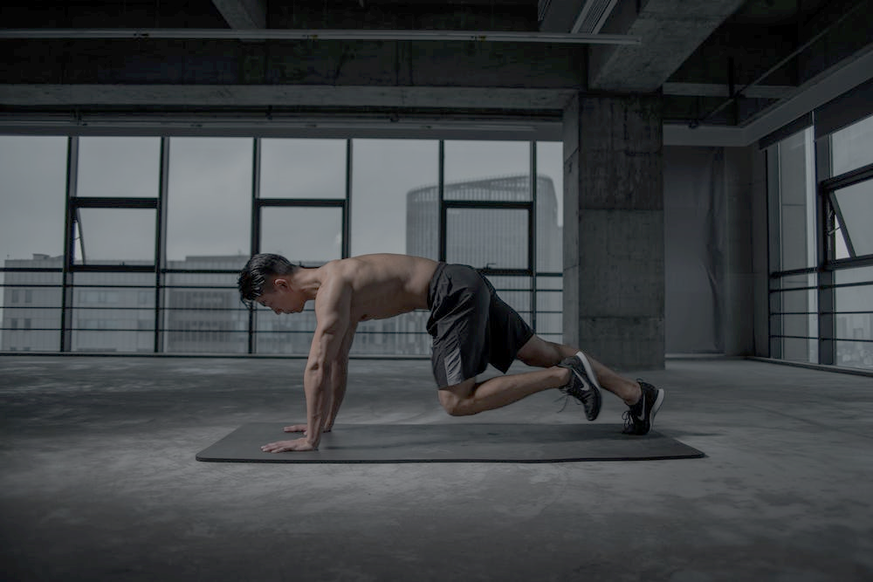
THANK YOU
For your time and cooperation.
http://127.0.0.1:5500/Home%20Page.html

